Slide 1
FILE UPLOAD & FILE DOWNLOAD
BY: Kaiyi Li
Jiayue Tu

Slide 2
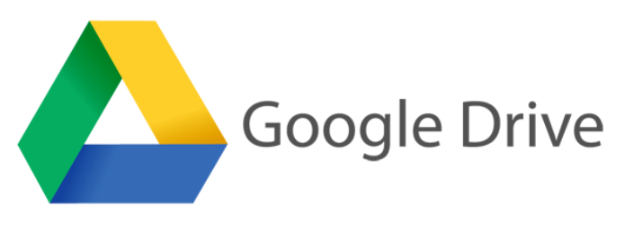



Cloud storage services

Slide 3
Cloud storage services
1990s – Online Backup Storage
1994 – AT&T – PersonaLink
2006 – Amazon – AWS S3
2008 – Dropbox – Personal Cloud Storage
2012 – Google – Google Drive

Slide 4
Basic Structure
CHAT
Client
……
Client
Connect
Connect
Server
file
file
AIR
DOWNLOAD
Client
Client

Slide 5
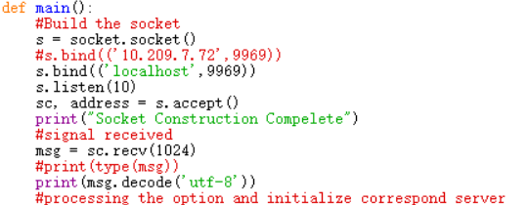
Logic
Socket Construction

Slide 6
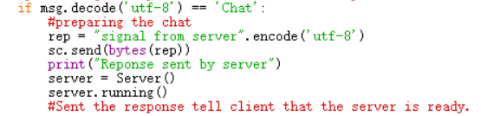
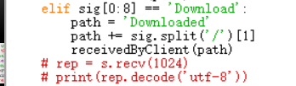
Logic
Main Server
Main Client

Slide 7
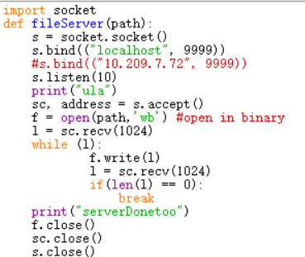
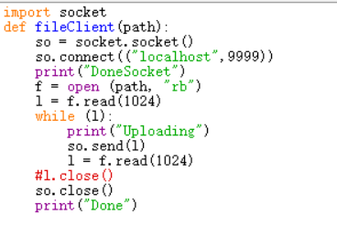
Logic
file_transfer server
file_transfer client

Slide 8
Improvements
Constant Server
Run multiple functions at the same time

Slide 9
Thanks for WatchinG!

